Slide 1
USER DEFINED FUNCTIONS

Slide 2
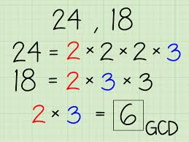
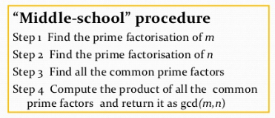
How to design and implement?
ALGORITHM
MAJOR TASK
MAJOR TASK

Slide 3
We Need an algorithm for prime factorization to make middle-school procedure into an algorithm.
As well as need an algorithm to find common prime factors.

Slide 4
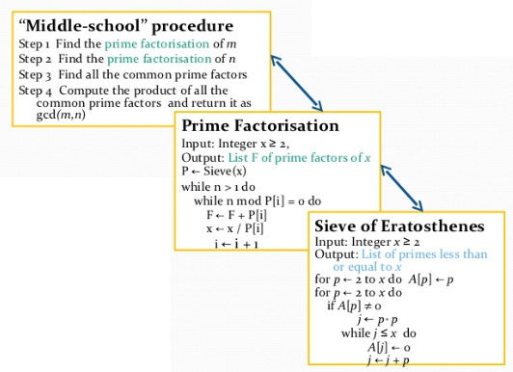
MAIN FUNCTION
SUB FUNCTION 1
SUB FUNCTION 2

Slide 5
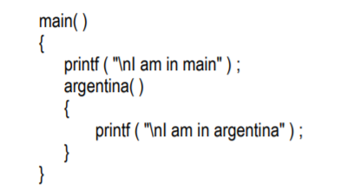
FUNCTIONS-PURPOSE
Functions break large computing tasks into smaller ones.
Avoids repetition of Codes.
Every C program has at least one function.
A function is a set of statements that take inputs, do some specific computation and produces output.

Slide 6
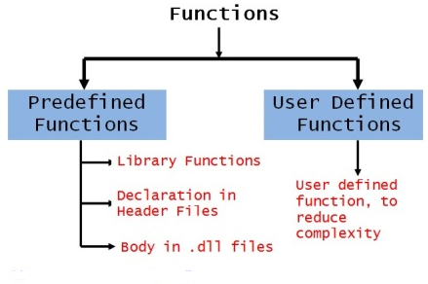
TYPES OF FUNCTIONS

Slide 7
Elements of the functions
Function prototype / function declaration
Function Call
Function definition
Actual Arguments
Formal Arguments
Return Value
Function name

Slide 8
Elements of Functions
1.Function prototype / function declaration
Syntax :
return_type function_name(arguments);
Eg: int add(int, int);
or
int add(int num1, int num2);

Slide 9
2. Function definition
Elements of Functions
Syntax :
return_type function_name(formal arguments)
{
----- function body ----
}
Eg: int add(int x, int y)
{
------
return c;
}

Slide 10
3. Function call
Elements of Functions
Syntax:
function_name(Actual Arguments);
Eg : add(a,b);
or
int result = add(a, b);

Slide 11
Elements of Functions
4. Actual arguments
The arguments used in the function call
5. Formal arguments
The arguments used in the function definition
6. Return Value
Return statement used to return the values back to the calling function.

Slide 12
/* Function to add two numbers */
void add(int,int); /* function declaration */
#include<stdio.h>
int main()
{
int a,b,d;
printf("Enter a,b:");
scanf("%d%d",&a,&b);
d= add(a,b); /* function call , a, b – actual arguments */
printf(“%d”,d);
}
int add(int x,int y) /* function definition x, y – formal arguments */
{
int c;
c=x+y;
return c;
}

Slide 13
Four types of function prototypes
Function with no argument and no return value
Function with no argument and with return value
Function with argument and no return value
Function with argument and with return value

Slide 14
1. Function with no argument and no return value
Function Prototypes
In this prototype, no data transfer takes place between the calling function and the called function. (ie from function call to function definition).
The function is only executed, does not return any value to the calling program.

Slide 15
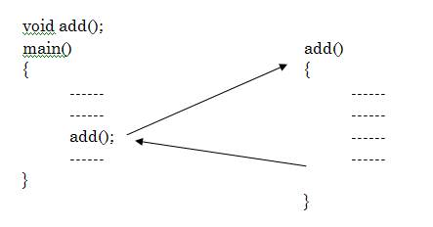
Example

Slide 16
//Program for no argument and no return value
#include<stdio.h>
void add(); // function declaration
main()
{
add(); // function call
}
void add() // function definition
{
int a, b, c;
a=10,b=20;
c=a+b;
printf(“sum is %d”,c);
}
Output:- sum is 30

Slide 17
2. Function with no argument and with return value
Function Prototypes
In this prototype, the calling program cannot pass any arguments to the called program.
But the called/invoked program may send some value return to the calling program.

Slide 18
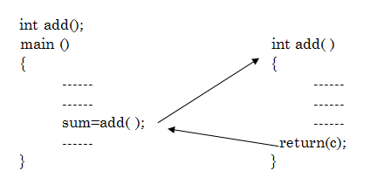
Example

Slide 19
//Program for no argument and with return value
#include<stdio.h>
int add(); // function declaration
int main()
{
int sum;
sum=add(); // function call
printf(“sum is %d”,sum);
}
int add() // function definition
{
int a, b, c;
a=10,b=20;
c=a+b;
return c ;
} Output:- sum is 30

Slide 20
3. Function with argument and no return value
Function Prototypes
In this prototype, data is transferred from calling function to called function.
i.e called function receives some data from the calling function and does not return any values to the calling function.

Slide 21
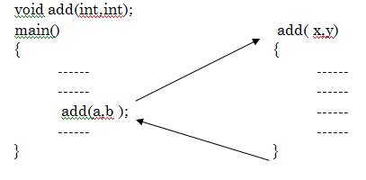
Example

Slide 22
//Program for argument and no return value
#include<stdio.h>
void add(int,int); // function declaration
int main()
{
int a=10,b=20;
add(a,b); // function call
}
void add(int a, int b) // function definition
{
int c;
c=a+b;
printf(“sum is %d”,c);
}
Output:- sum is 30

Slide 23
4. Function with argument and with return value
Function Prototypes
In this prototype, the data is transferred between the calling function and called function.
i.e the called function receives some data from the calling function and return a value to the calling function.

Slide 24
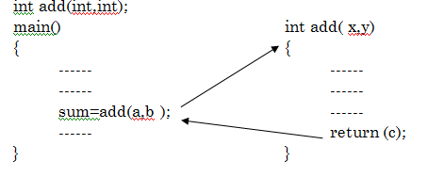
Example

Slide 25
//Program for argument and with return value
#include<stdio.h>
int add(int,int); // function declaration
int main()
{
int a=10,b=20,c;
c = add(a, b); // function call
printf(“sum is %d”,c);
}
int add(int a,int b) // function definition
{
int c;
c=a+b;
return c ;
}
Output:- sum is 30

Slide 26
Sample Programs
1. Write a program to find the GCD of a given numbers
Test Data :
Input :
98 56
Expected Output :
GCD : 14

Slide 27
Solution
#include <stdio.h>
int findgcd(int a, int b)
{
int r;
while( b!=0 ){
r = a % b;
a = b;
b = r;
}
return a;
}
int main()
{
int a = 98, b = 56;
int gcd;
gcd = findgcd(a,b);
printf(“%d”,gcd);
return 0;
}

Slide 28
Sample Programs
2. Write a program in C to get the factors of a given number.
Test Data :
Enter a number :
10
Expected Output :
1 2 5 10

Slide 29
Solution
#include <stdio.h>
void FindFactors(int num){
int i;
printf("Factors of %d are: ", num);
for (i = 1; i <= num; ++i) {
if (num % i == 0) {
printf("%d ", i);
}
}
}
int main() {
int num;
printf("Enter a number : ");
scanf("%d", &num);
FindFactors(num);
return 0;
}

Slide 30
Sample Programs
3. Write a program in C to convert decimal number to binary number using the function
Test Data :
Enter decimal number :
65
Expected Output :
The Binary value is : 1000001

Slide 31
Solution
long toBin(int);
int main()
{
long bno;
int dno;
printf(" Enter any decimal number : ");
scanf("%d",&dno);
bno = toBin(dno);
printf("\n The Binary value is : %ld\n\n",bno);
return 0;
}
long toBin(int dno)
{
long bno=0,remainder,f=1;
while(dno != 0)
{
remainder = dno % 2;
bno = bno + remainder * f;
f = f * 10;
dno = dno / 2;
}
return bno;
}

Slide 32
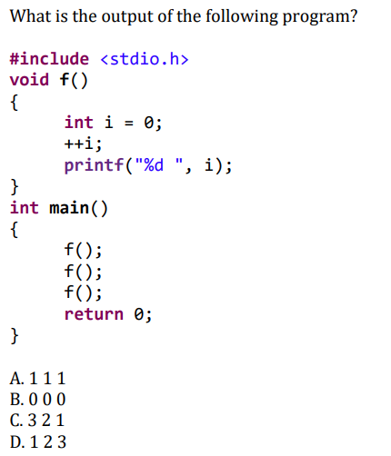
QUIZ
Answer : A

Slide 33
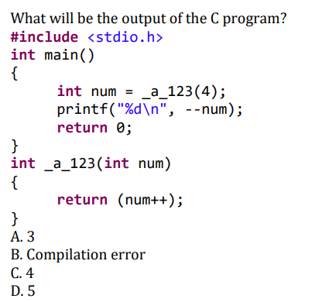
QUIZ
Answer : A

Slide 34
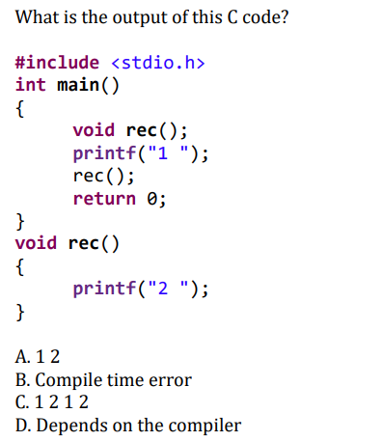
QUIZ
Answer : A

Slide 35
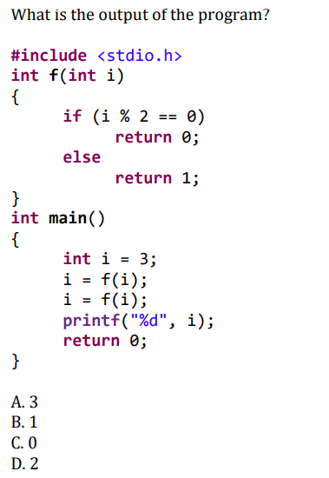
QUIZ
Answer : B

Slide 36
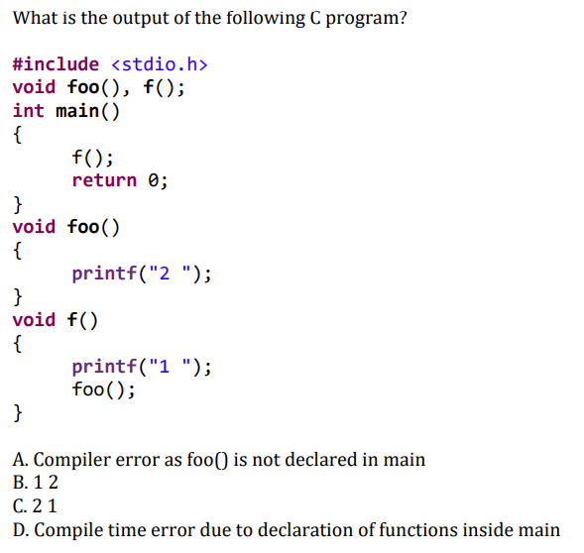
QUIZ
Answer : B

Slide 37
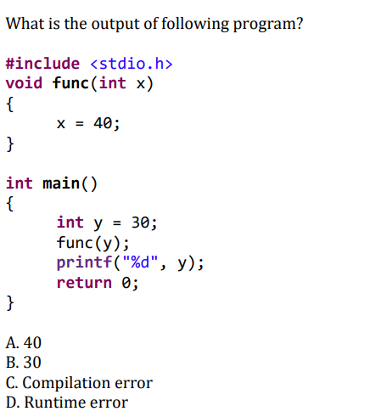
QUIZ
Answer : B

Slide 38
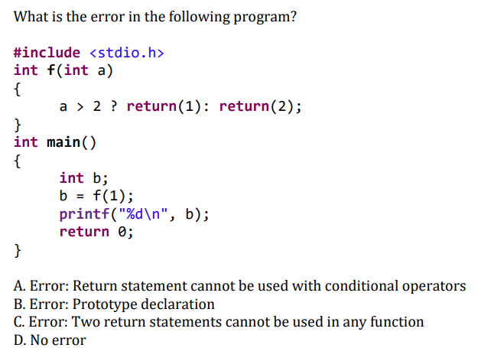
QUIZ
Answer : B

Slide 39
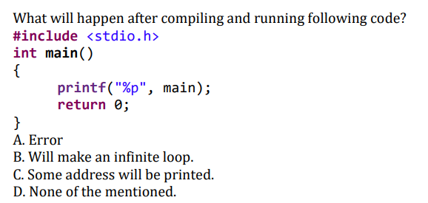
QUIZ
Answer : C

